Slide 1

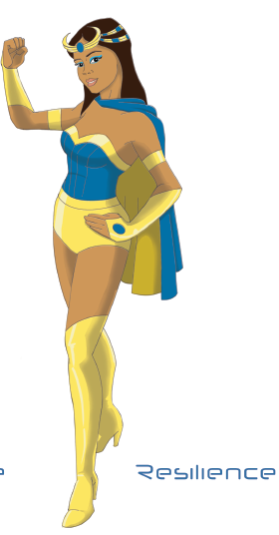
Zero Waste Lunch Superheroes
Please, join Recycle Smart’s Superhero, Resilience, on her mission to help heal the planet!
Let’s take care of the planet together. By taking responsibility for our actions everyday, we are helping the planet everyday!

Slide 2
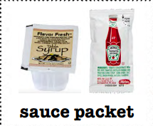
What are the zero waste alternatives?
Take a moment to brainstorm with your group and then share.

Slide 3
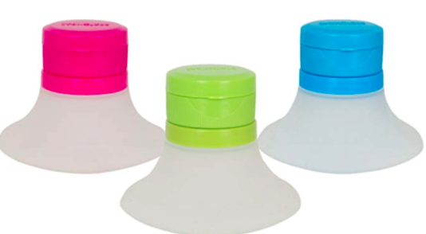
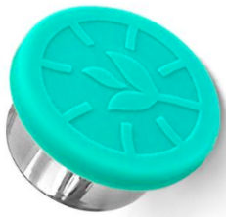
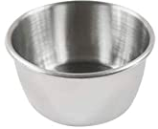
A reusable container!!!
Did you come up with alternatives like these? Did you think of even more ideas? Good job!

Slide 4
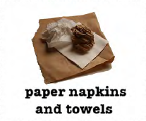
What are the zero waste alternatives?
Take a moment to brainstorm with your group and then share.

Slide 5
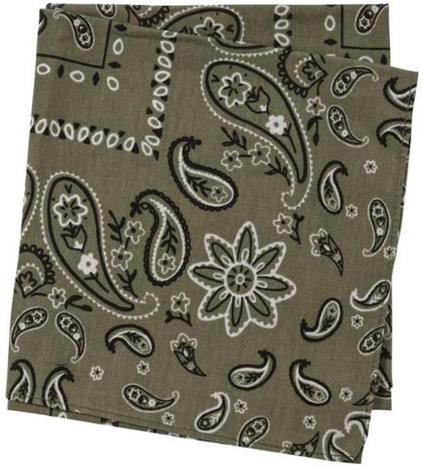
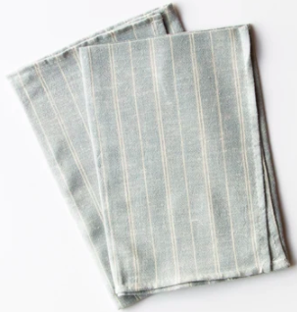
A reusable napkin, bandanna, or handkerchief!!!
Did you come up with alternatives like these? Did you think of even more ideas? Good job!

Slide 6

What are the zero waste alternatives to single-use straws?
Take a moment to brainstorm with your group and then share.

Slide 7

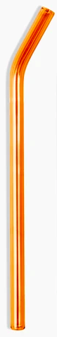
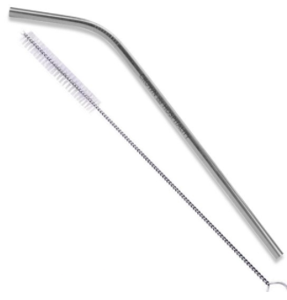
A reusable metal, glass, and bamboo straws!!!
Did you come up with alternatives like these? Did you think of even more ideas? Good job!

Slide 8
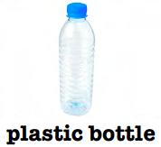
What are the zero waste alternatives?
Take a moment to brainstorm with your group and then share.

Slide 9
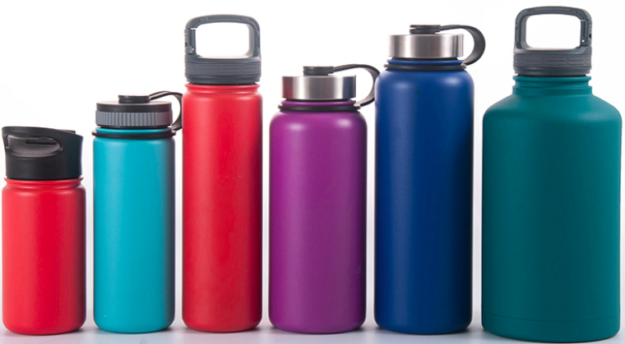
A reusable bottle!!!
Did you come up with alternatives like these? Did you think of even more ideas? Good job!

Slide 10
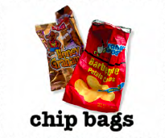
What are the zero waste alternatives?
Take a moment to brainstorm with your group and then share.

Slide 11
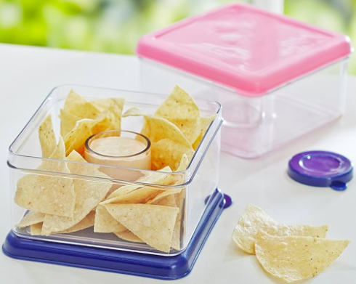
A reusable container!!!
Did you come up with alternatives like these? Did you think of even more ideas? Good job!

Slide 12
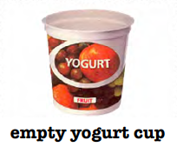
What are the zero waste alternatives?
Take a moment to brainstorm with your group and then share.

Slide 13
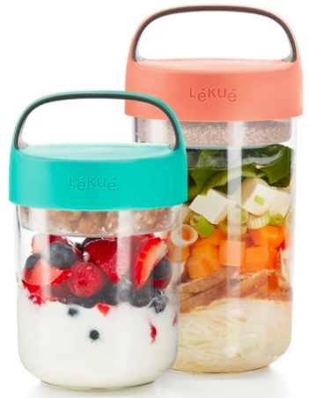
A reusable container!!!
Did you come up with alternatives like these? Did you think of even more ideas? Good job!

Slide 14
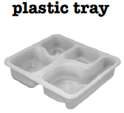
What are the zero waste alternatives?
Take a moment to brainstorm with your group and then share.

Slide 15
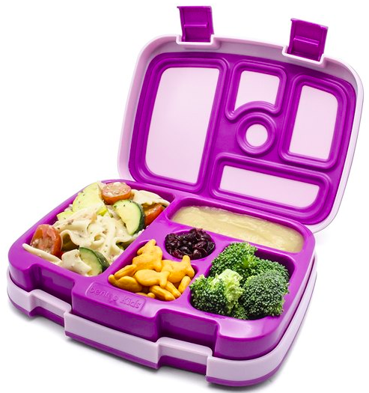
A reusable container!!!
Did you come up with alternatives like these? Did you think of even more ideas? Good job!

Slide 16
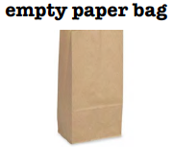
What are the zero waste alternatives?
Take a moment to brainstorm with your group and then share.

Slide 17
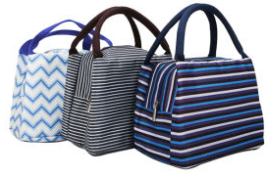
A reusable lunch bag!!!
Did you come up with alternatives like these? Did you think of even more ideas? Good job!

Slide 18
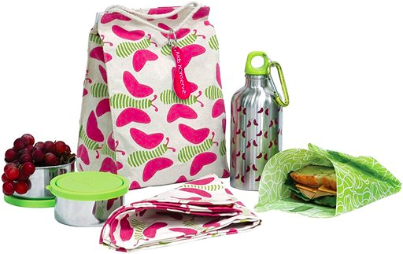
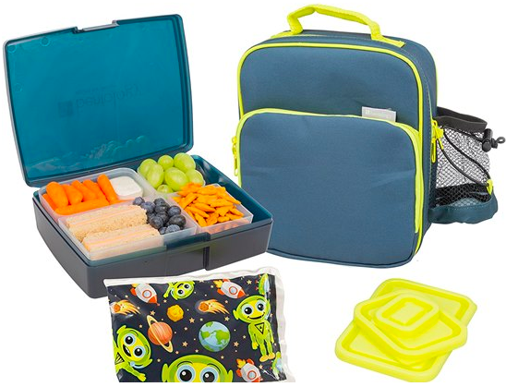
Good job and keep up your Zero Waste Superhero actions!

Slide 19
Thank you for taking care of the planet!
You are now a Zero Waste Lunch Superhero Expert!

