Slide 1
Collection Services RFP
Pre-Proposal Meeting
November 15, 2024
Pre-Proposal Meeting
Notes:
Jen 1 – 5
Judith 6 - 8
David 9 – 15
Ashley 16 – 20
David – 21
Emily - 22

Slide 2
RFP Schedule
Questions due –December 6
Answers posted – December 20
Proposals due –February 7 - 3 p.m.
Evaluation –February – March
Interviews – March 10 – 14
Board Presentations – March 27
Negotiation – April - July
Award – July 24
Services begin – March 1, 2027

Slide 3
Process Integrity Policy
The Process Integrity Policy:
No gifts
Limits campaign contributions
Lays out explicit communication guidelines
The cover letter for each proposal:
must unequivocally indicate that the proposer unconditionally agrees to the policy.
acknowledge that the proposer is responsible for ensuring compliance with the policy on behalf of their employees, agents, consultants, lobbyists, or other entities and individuals acting on their behalf.
A proposer’s failure to adhere to any section of the policy may result in the Authority disqualifying that proposer from award of a franchise.

Slide 4
Communication
Email: RFP2024@recyclesmart.org
  With questions.
  To receive subsequent communications and addenda.
  To submit proposal/s, exceptions, cost forms and attachments.
RFP Website: www.recyclesmart.org/rfp-collection-services/

Slide 5
How to a Submit Proposal
Email proposals RFP2024@recyclesmart.org,
  SUBJECT: CCCSWA Proposal Submittal, Email X of X
Your email submission may contain a link to SharePoint, Drop Box, a webpage, or another means of submitting large documents
Technical Proposals = PDF
Cost Proposal Forms = Excel
Proposed exceptions to the draft Agreement = Word

Slide 6
Proposal Outline
Cover Letter
Executive Summary
Company Description
  Business Structure
  Collection Experience
  Service Initiation Experience
  Key Personnel
  Labor Agreements and Wages
  Past Performance Record
  Financial Information

Slide 7
Proposal Outline
2. Technical Proposal For Base Services
  Collection
  Collection Service Quality
  Vehicle Maintenance Plan
  Zero Emissions Vehicle Implementation Plan
  Maintenance Yard
  Emerging Technologies
  Inspection for Unpermitted / Excluded Waste
  Contamination Detection and Reduction Plan
  Public Education, Outreach, & Technical Assistance Plan
  Customer Service
  Billing
  Implementation Plan
  Subcontractors
  Management and Customer Service Systems

Slide 8
Proposal Outline
Technical Proposal For Alternative Bid Services (Required)
Innovative and Cost-Saving Services (Optional)
Environmental Considerations
Acceptance of RFP and Franchise Agreement
Cost Proposal
  Base Services (Required)
  Alternative Services (Required)
  Innovative & Cost-Saving Services (Optional)
Other Proposal Forms
  Secretary’s Certificate
  Anti-Collusion Affidavit
  Iran Contracting Act Certification

Slide 9
Collection
COLLECT | DELIVER TO
Solid Waste | 1300 Loveridge Road, Pittsburg
Recyclable Materials | 1300 Loveridge Road, Pittsburg
Commingled Organics | 1300 Loveridge Road, Pittsburg
Commercial Food Scraps | 951 Waterbird Way, Martinez

Slide 10
Two Organics Programs
Commingled Organics
  Collected From
    All Sectors
  Allowable Materials
    Yard Trimmings
    Food Scraps
    Uncoated Food-Soiled Paper
    Clean Wood
  Allowable Bags
    Compostable Paper
    BPI Certified Compostable Plastic
  Diversion Method = Composting

Slide 11
Two Organics Programs
Commercial Food Scraps
  Collected From
    High-Volume Commercial Food Scrap Generators
    Schools
  Allowable Materials
    Food Scraps
    Paper Towels & Napkins
    Coffee Filters & Tea Bags
  Allowable Bags
    Compostable Paper
    BPI Certified Compostable Plastic
    Non-Compostable Clear Plastic
  Diversion Method = AD

Slide 12
Notable Local Conditions
The Community of Canyon
Castle Hill Road Bridge
Hard-to-Serve Areas
Public Schools
Rossmoor Senior Adult Community
  Contact = Lisa Lankford llankford@rossmoor.com

Slide 13
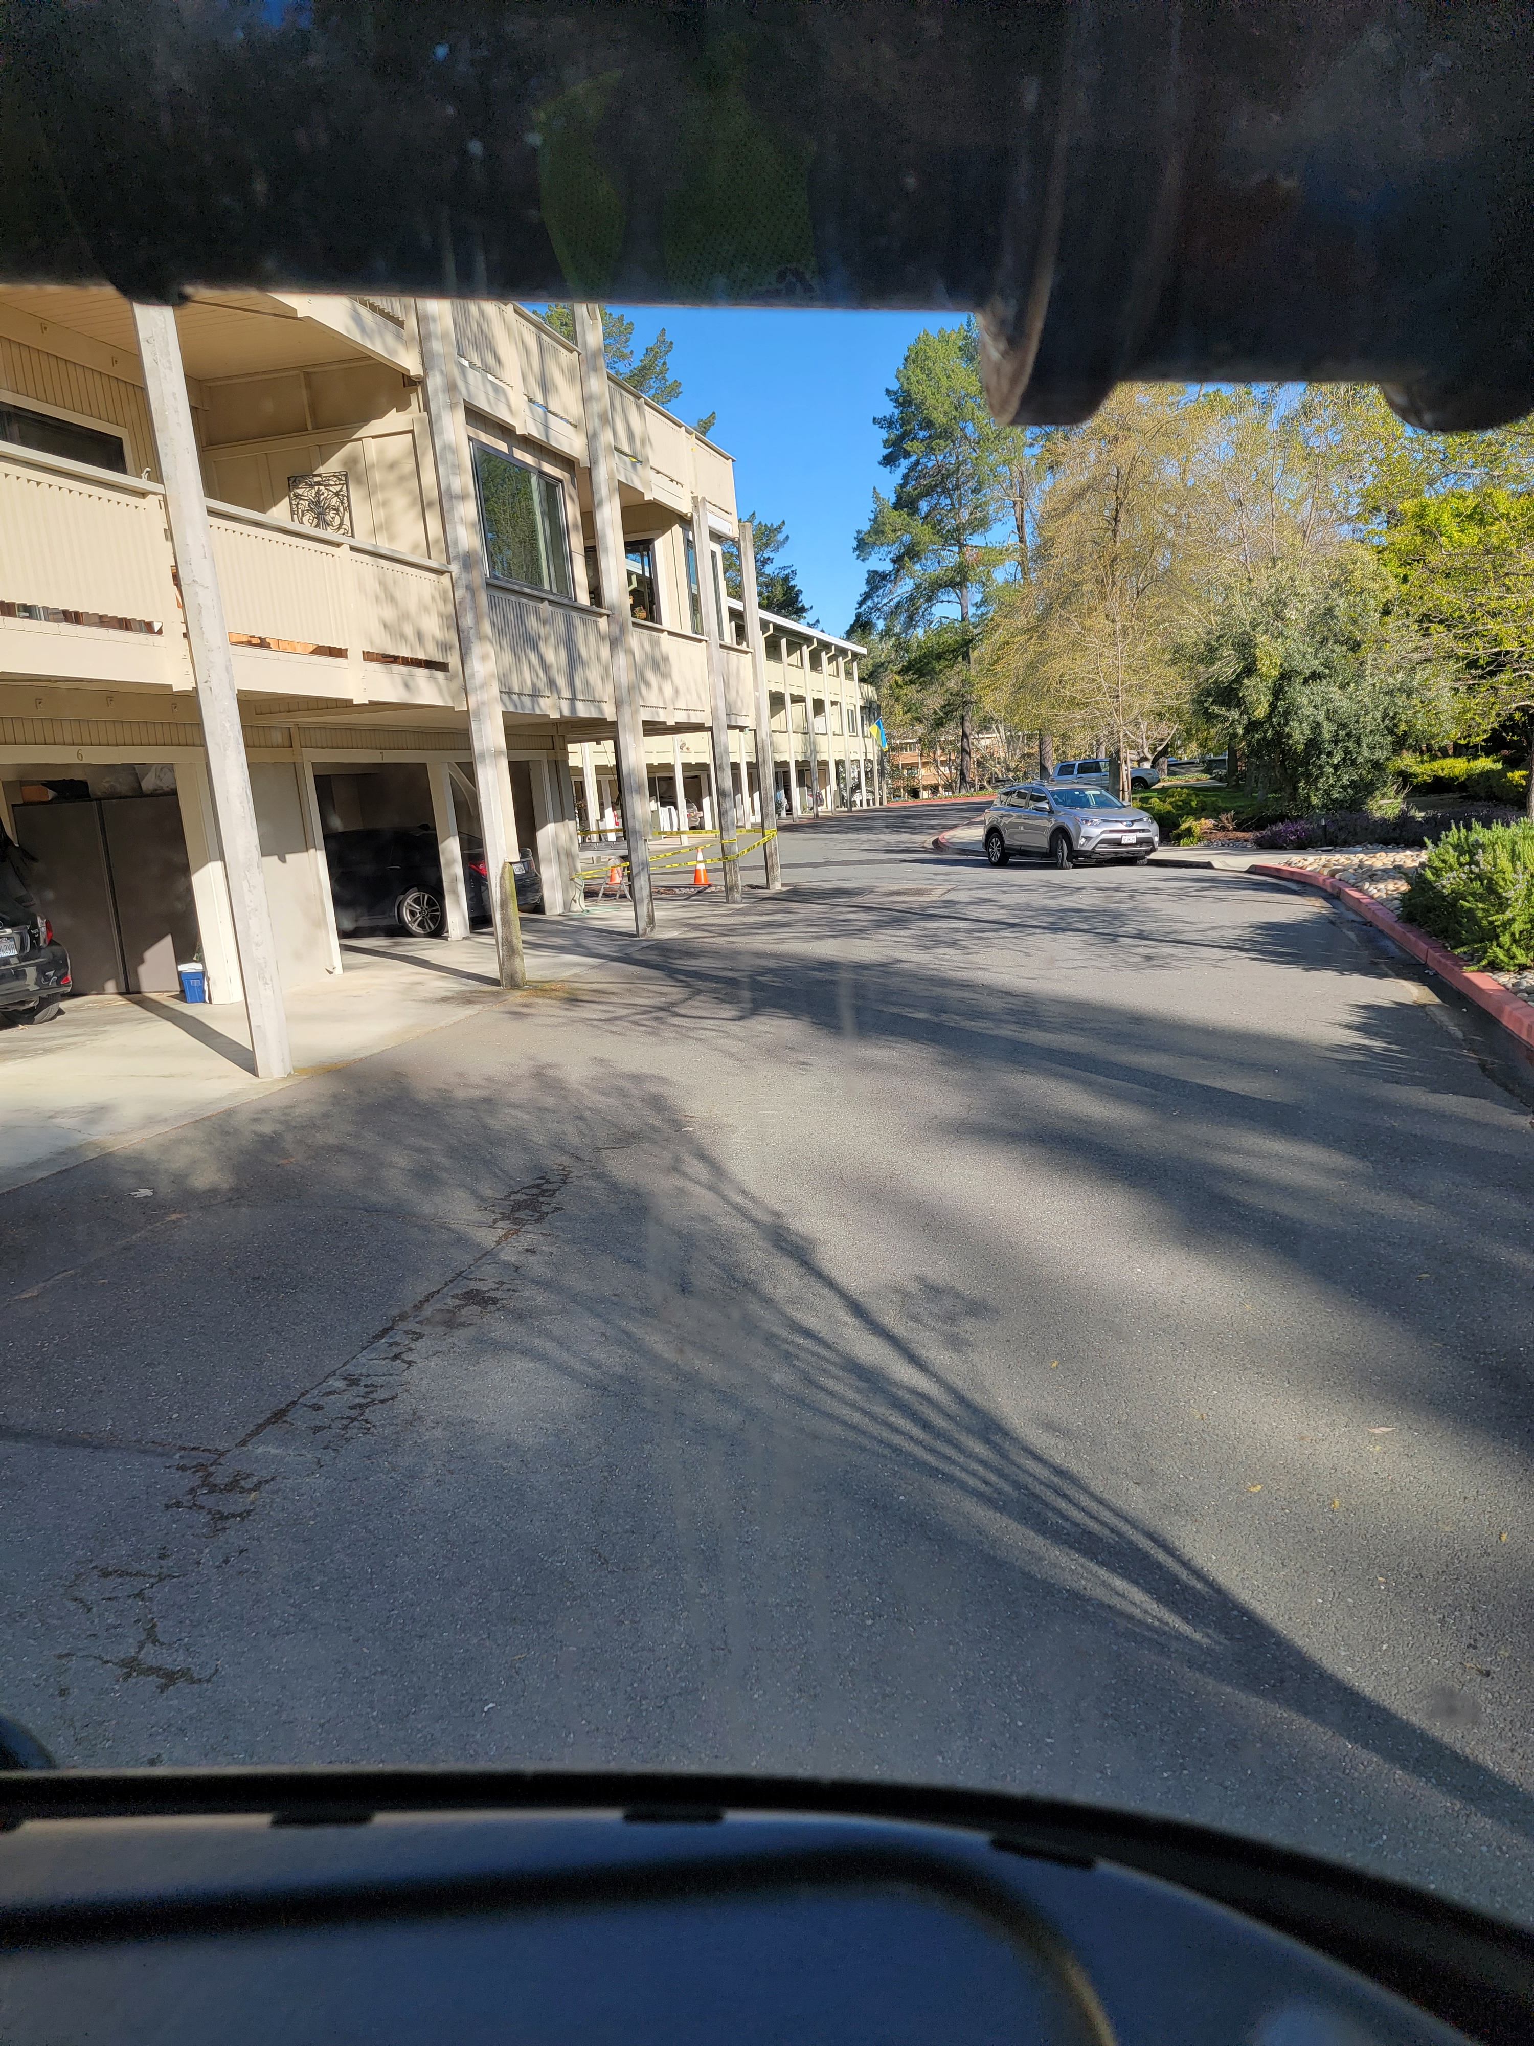
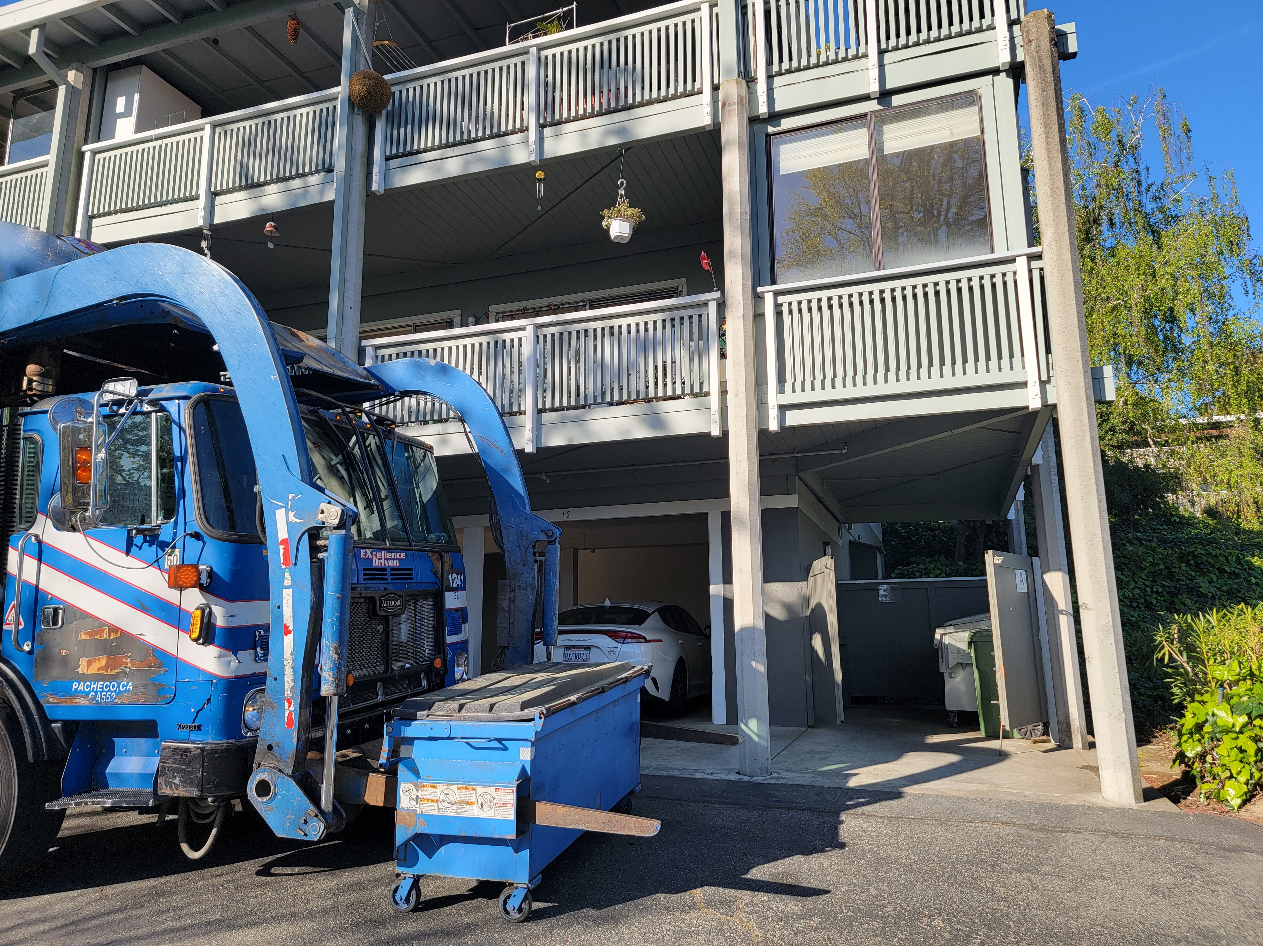
Rossmoor “Entries”

Slide 14
Vehicles
Meet, but not exceed, State requirements for Zero Emission Vehicles (ZEV’s)
Percentage of ZEV’s used in the Authority’s service area no higher than the ZEV percentage for the hauler’s fleet Statewide
Phase in ZEV costs as they are incurred
No requirement for all new vehicles
No preference for vehicle fuel

Slide 15
Key Business Terms
15-year term
Use existing carts and bins
Available maintenance yard site
Cost-based rate adjustments
  Every 4 years
  Allows for growth
  Includes revenue reconciliation
Multi-index rate adjustments in other years
“Bundled” recyclables and organics service at no additional charge for all sectors
Hiring of displaced workers

Slide 16
Required Alternative Bids
  Second organics and recycling carts for single-family homes at no additional charge
  Unlimited single-family organics and recycling
  Battery collection for multi-family dwellings
  Re-label all carts by June 30, 2028
  Replace all carts by June 30, 2028
  Weekend collection of downtown public litter containers

Slide 17
Billing & Customer Service
“Customer is always right” approach, shall not challenge or dispute the Customer’s assertions or complaints, and shall at all times prioritize Customer satisfaction.

Slide 18
Billing & Customer Service
Locate CSRs within 30 miles of the Authority service area (You may submit an optional alternative cost saving proposal for a more remote call center)
Require five dedicated CSRs and one dedicated Customer Service Manager for our service area
Quarterly billing in advance of services for single family and monthly billing in advance of services for commercial and multifamily
Vacation hold: Once annually at no additional cost for up to three consecutive weeks
Contractor shall maintain a local or toll-free telephone number and the ownership will be transferred to the Authority at the termination of this Agreement

Slide 19
Outreach & Technical Assistance
Authority will develop, design, print, and mail outreach materials
Contractor will store and distribute
Annual Public Education & Outreach Plan
Meet monthly to discuss outreach and technical assistance
Translate educational materials in up to three languages
Authority website (RecycleSmart.org) will be hub for education
Maintain and purchase mailing lists
Annual truck signs (up to 3 designs per year)

Slide 20
Technical Assistance
One FT dedicated Municipal Contract Manager and Five FT dedicated Sustainability Advisors
Implement and improve service, resolve complaints, reporting, conduct outreach to community groups and schools
Diversion Opportunity Assessments – Commercial, Multifamily and Single-Family
Community Events

Slide 21
Special Events
Provide solid waste, recycling and organics service for 18 events.
Work with event organizer to develop waste management plan, review food booths and foodware use, provide recommendations for waste prevention and reduction.
Event collection stations (“Clear Streams”) and Waste Station Monitors
Event collection station “Loan Program”
Public education booth: storage, setup, participation

Slide 22
Evaluation Criteria
Environment
  Reducing greenhouse gas emissions
  Diverting waste from landfills
    Contamination detection and reduction
Service Quality
  Collection on the scheduled day
    Customer credits for missed collections
  Containers replaced upright with lids closed
  Minimize litter, spills, and leaks
Cost
Technical Proposal

Slide 23
Exceptions to Agreement
If differences between RFP and the draft Agreement, the Agreement prevails.
For each exception, proposer shall:
  identify the exception, explain its concern, and provide alternative language for consideration by the Authority.
To document exceptions:
  proposer shall record exceptions and proposed alternative language directly in an electronic (MS Word) version of the draft Agreement using the track changes and comments functions.
Proposer must complete the cost forms assuming no proposed exceptions to the Agreement will be accepted by the Authority.
  Use Word doc to propose cost reductions if exceptions are accepted

